Slide 1
Overmodification
Quantity Implicatures
Models and Methods
Dasha Popova
24.01.2026

Slide 2
The Gricean maxims of conversation: clashes, opting-out, flouting
Flouting quality:
Well, that’s just great! (sarcasm)
What a hot day! (irony)
The lawyer is a shark. (metaphor)
The assignment took like 1000 hours. (hyperbole)
Opting out (or attempting to opt out) of relevance:
(5) A: How do I put this table together?
B: Very carefully.
Flouting “Be brief”:
(6) A newspaper review of a newly opened play says that, in the third act, “Soap opera star Rachel Singer produced a series of sounds corresponding closely to the score of an aria from Rigoletto.”

Slide 3
The Gricean maxims of conversation: clashes, opting-out, flouting
Opting out of quantity:
No comment.
Mistakes were made.
Flouting quantity with tautologies (Grice maintained that tautologies are, strictly speaking, extreme violations of quantity, since they can’t help but be true):
(3) Boys will be boys. (4) A phone is a phone.
Flouting quantity to achieve a politeness effect:
(5) a. Can you pass the salt?
b. Could you open the window (please)?
c. Do you know what time it is?

Slide 4
The Gricean maxims of conversation: clashes, opting-out, flouting
Clash between relevance and quality:
Source: The detective show Monk, ‘Mr. Monk goes to the Carnival’
Context: The subject is whether Mr. Monk, who earlier had a nervous breakdown, is ready to be put back on the police force. Stottlemeyer is Monk’s friend and former captain.
Commission member Is Mr. Monk ready to be put back on the force?
Stottlemeyer Mr. Monk has excellent instincts.
Commission member Yes, but is he ready to be reinstated?
Stottlemeyer He is an excellent investigator.
Commission member Captain, please. . .

Slide 5
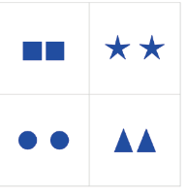
Linguistic redundancy: color and quantity (Zevakhina et al. 2024)

Slide 6
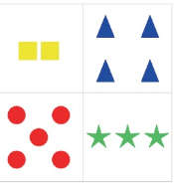
Linguistic redundancy: color and quantity (Zevakhina et al. 2024)

Slide 7
Linguistic redundancy: color and quantity (Zevakhina et al. 2024)
Hypothesis 1: the over-specification of small (2–4) cardinalities is expected to be higher than the over-specification of color
Hypothesis 2: visual context influences over-specification rates.
Hypothesis 2A: color over-specification is predicted to be higher in polychrome (visually contrastive) than in monochrome (visually neutral) contexts.
Hypothesis 2B: the over-specification of small (2 to 4) cardinalities is expected to be higher in multi-cardinality contexts than in one-cardinality contexts.
Hypothesis 2C: the over-specification of borderline (5–8) cardinalities is expected to be higher in an ordered design than in an unordered design.

Slide 8
Linguistic redundancy: color and quantity (Zevakhina et al. 2024)
Hypothesis 3 deals with the modifier position.
Hypothesis 3A: the prenominal position is more typical than the postnominal position for color adjectives in referential communication.
Hypothesis 3B: the prenominal position is more typical than the postnominal position for numerals.
Hypothesis 4: the speaker adheres to either minimal specification or over-specification of colored objects of small (2–4) cardinalities or of uncolored objects of borderline (5–8) cardinalities throughout a whole communication.

Slide 9
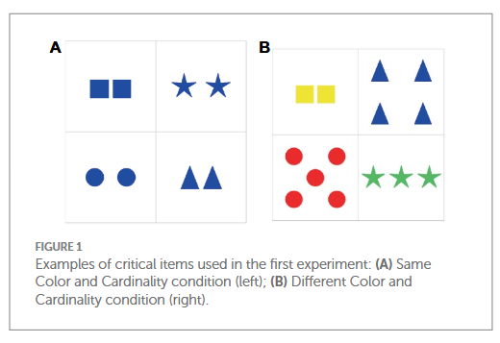
Linguistic redundancy: color and quantity (Zevakhina et al. 2024)
Expected responses: a bare plural form of a noun (e.g., ‘triangles’), numeral + noun (e.g., ‘four triangles’), color adjective + noun (e.g., ‘blue triangles’), numeral + color adjective + noun (e.g., ‘four blue triangles’).

Slide 10
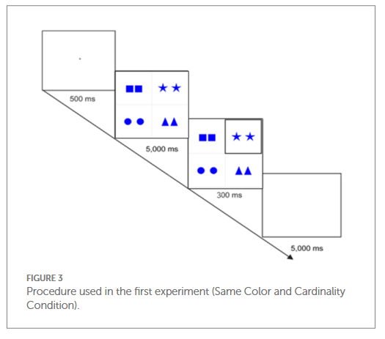
Linguistic redundancy: color and quantity (Zevakhina et al. 2024)
Expected responses: a bare plural form of a noun (e.g., ‘triangles’), numeral + noun (e.g., ‘four triangles’), color adjective + noun (e.g., ‘blue triangles’), numeral + color adjective + noun (e.g., ‘four blue triangles’).

Slide 11
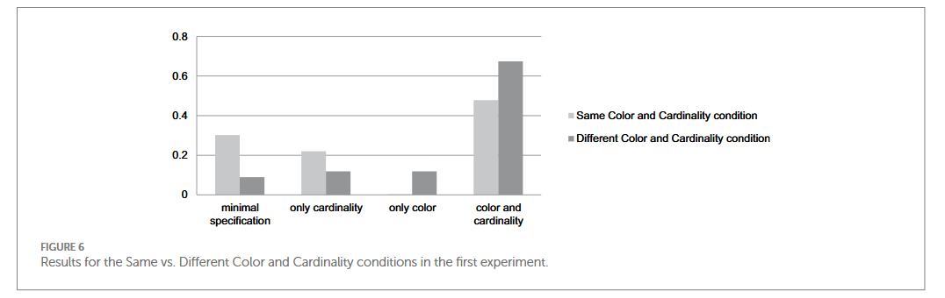
Linguistic redundancy: color and quantity (Zevakhina et al. 2024)
Expected responses: a bare plural form of a noun (e.g., ‘triangles’), numeral + noun (e.g., ‘four triangles’), color adjective + noun (e.g., ‘blue triangles’), numeral + color adjective + noun (e.g., ‘four blue triangles’).

Slide 12
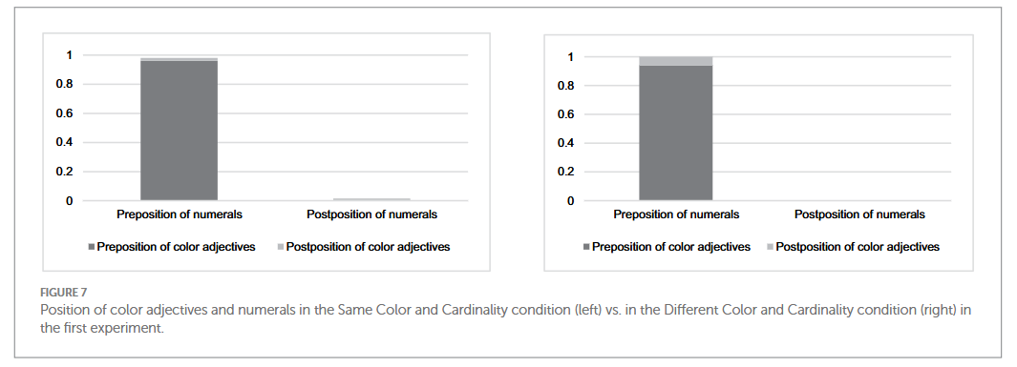
Linguistic redundancy: color and quantity (Zevakhina et al. 2024)
Expected responses: a bare plural form of a noun (e.g., ‘triangles’), numeral + noun (e.g., ‘four triangles’), color adjective + noun (e.g., ‘blue triangles’), numeral + color adjective + noun (e.g., ‘four blue triangles’).

Slide 13
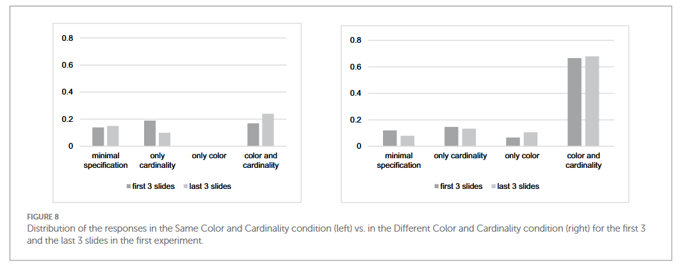
Linguistic redundancy: color and quantity (Zevakhina et al. 2024)
Expected responses: a bare plural form of a noun (e.g., ‘triangles’), numeral + noun (e.g., ‘four triangles’), color adjective + noun (e.g., ‘blue triangles’), numeral + color adjective + noun (e.g., ‘four blue triangles’).

Slide 14
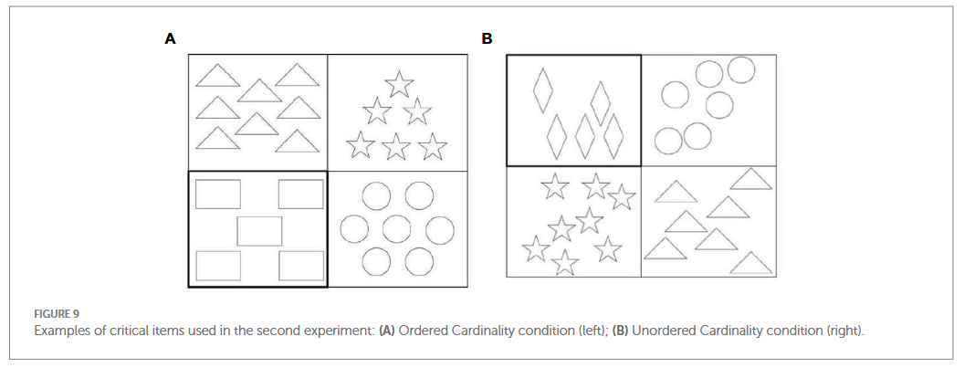
Linguistic redundancy: color and quantity (Zevakhina et al. 2024)
The second experiment tested cardinalities ranging from 5 to 8 and had a between-subjects design (Ordered vs. Unordered conditions).

Slide 15
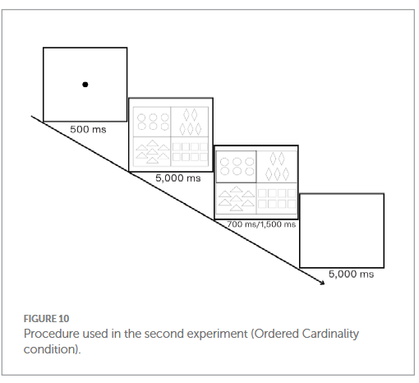
Linguistic redundancy: color and quantity (Zevakhina et al. 2024)
The second experiment tested cardinalities ranging from 5 to 8 and had a between-subjects design (Ordered vs. Unordered conditions).

Slide 16
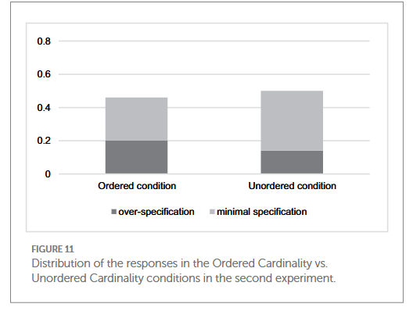
Linguistic redundancy: color and quantity (Zevakhina et al. 2024)
The second experiment tested cardinalities ranging from 5 to 8 and had a between-subjects design (Ordered vs. Unordered conditions).

Slide 17
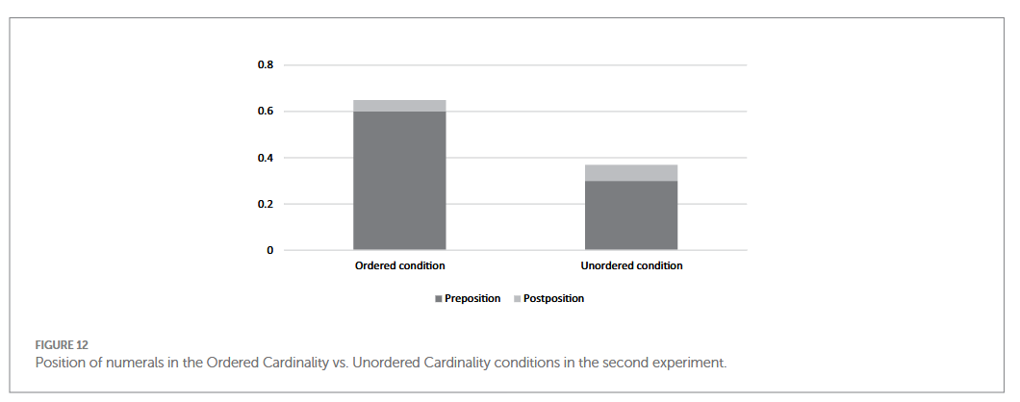
Linguistic redundancy: color and quantity (Zevakhina et al. 2024)
The second experiment tested cardinalities ranging from 5 to 8 and had a between-subjects design (Ordered vs. Unordered conditions).

Slide 18
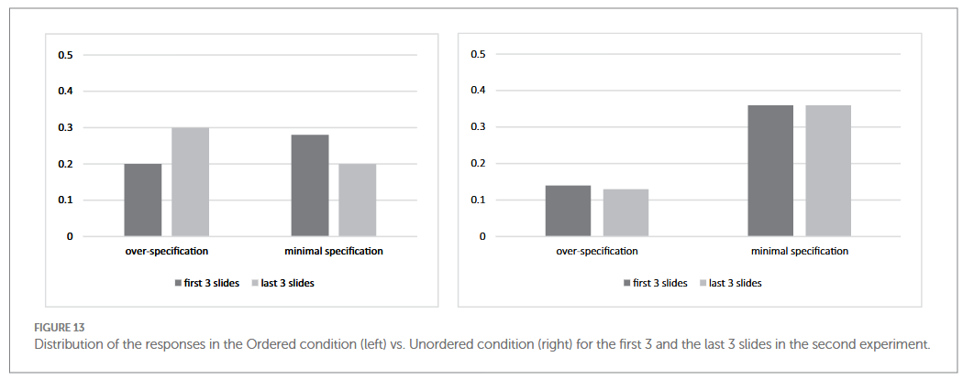
Linguistic redundancy: color and quantity (Zevakhina et al. 2024)
The second experiment tested cardinalities ranging from 5 to 8 and had a between-subjects design (Ordered vs. Unordered conditions).

Slide 19
Linguistic redundancy: color
Overinformativity – a quality of an object is specified that is unique in the context and thus redundant (Rubio-Fernandez, 2016).
Give me the blue cup!
Context 1: blue cup, red cup, green spoon
Context 2: blue cup, red knife, green spoon
Context 3: blue cup, blue knife, blue spoon
In which context is the utterance (1) informative? overinformative?
Overinformativity violates the Maxims of Quantity, then why is it possible?

Slide 20
Linguistic redundancy: color
Overinformativity – a quality of an object is specified that is unique in the context and thus redundant (Rubio-Fernandez, 2016).
Overinformativity violates the Maxims of Quantity, then why is it possible?
Rubio-Fernandez proposes to switch from Quantity to Efficiency: overmodification allows the listener to identify the intended object more easily, color is an important characteristic of certain kinds of objects.
Color is special, other dimensions like shape or size usually don’t get overspecified.
Color is usually absolute (does not change from object to object), inherent for a lot of objects, often constant and perceptually salient.
Overmodification occurs more often in contexts with objects of different colors.
Atypical (green swan, purple banana) gets overmodified more often than objects of variable colors (red dress, black cup), which, in turn, get overmodified more often than stereotypically colored objects (grey wolf, yellow lemon).
If color matters for a certain category of objects, it gets overmodified more often (red dress vs. red circle)

Slide 21
Conversational Implicature
Definition (adapted from Hirschberg 1985:§2)
Proposition q is a conversational implicature of utterance U by agent A in context C if, and only if:
i. A believes that it is mutual, public knowledge of all the discourse participants in C that A is obeying the cooperative principle.
ii. A believes that, to maintain (i) given U, the hearer will assume that A believes q.
iii. A believes that it is mutual, public knowledge of all the discourse participants that (ii) holds.

Slide 22
Conversational Implicature: calculability: Quantity-based
Kyle to Ellen: “I have $9.”
Conversational implicature: Kyle does not have > $9.
a. Contextual premise: Both Kyle and Ellen need $10 for their movie tickets.
b. Contextual premise: It is mutual, public information that Kyle has complete knowledge of how much money he has on him.
c. Assume Kyle is cooperative at least insofar as he is obeying Quantity and Quality.
d. Then he will assert what is maximally relevant, informative, and true.
e. By (a), the proposition p that Kyle has $n for 9 < n <= 10 is more informative and relevant in this context than the proposition that he has $9.
f. Therefore, Kyle must lack sufficient evidence to assert p.
g. By (b), he must lack evidence for p because it is false.
Once we have calculated the implicature and agreed that it was intended, then we can also conclude that Kyle doesn’t have $11, $12, etc. These are unlikely to be conversational implicatures, though, since they are not relevant in our context.

Slide 23
Conversational Implicature: calculability: Relevance-based
A: Which city does Barbara live in?
B: She lives in Russia.
Conversational implicature: B does not know which city Barbara lives in.
a. Contextual premise: B is forthcoming about Barbara’s personal life.
b. Assume B is cooperative.
c. Assume, towards a contradiction, that B does know which city Barbara lives in (the negation of the implicature).
d. Supplying the city’s name would do better on Relevance and Quantity than supplying just the country name.
e. The contextual assumption is that B will supply such information.
f. This contradicts the cooperativity assumption (b).
g. We can therefore conclude that the implicature is true.

Slide 24
Conversational Implicature: tests
Cancellation: encoding semantically the negation of the target meaning. If the result seems consistent, then the target meaning is likely an implicature.
Suspension: encoding semantically a lack of knowledge about the truth of the target meaning or its negation. If the result seems consistent, then the target meaning is likely an implicature.
Reinforcement: encoding semantically the target meaning itself. If the result seems non-redundant, then the target meaning is likely an implicature.

Slide 25
Conversational Implicature: tests
Example: The play was good.
a. Target meaning: the play was not excellent
b. Cancellation: The play was good – in fact, it was excellent.
c. Suspension: The play was good, maybe even excellent.
d. Reinforcement: The play was good, but not excellent.

Slide 26
Conversational Implicature: tests
Example: Some of the puppies escaped.
a. Target meaning: not all of the puppies escaped
b. Cancellation: Some – in fact all! – of the puppies escaped. (“not not all”)
c. Suspension: Some, maybe even all, of the puppies escaped.
d. Reinforcement: Some, but not all, of the puppies escaped.

Slide 27
Conversational Implicature: tests
Example: The food was edible.
a. Target meaning: the food was not delicious
b. Cancellation:
c. Suspension:
d. Reinforcement:

Slide 28
Conversational Implicature: tests
Calculation
Indeterminacy: Hirschberg (1985:24) writes, “a conversational implicatum is often a disjunction of several possible interpretations of an utterance and is often indeterminate”
Nonconventionality: the inferences should derive, not (solely) from lexical or constructional idiosyncrasies, but rather from pragmatic interactions

Slide 29
Quantity Implicatures
Quantity Implicatures are calculated based on the Maxim of Quantity:
Q_{C}-implicatures (closed, small number of alternatives):
scalar implicatures
free choice inferences: You can take an apple or an orange (implies: not both)
Q_{O}-implicatures (open):
exhaustive answers, question-answer implicatures: D: Who looked at the papers assigned for the class? A: Zoe and Anton (impl.: just them)
conditional perfection: А: If you mow the lawn, I’ll give you five dollars. Implicature: If you don’t mow the lawn, I won’t give you five dollars

Slide 30
Q_{C}-implicatures calculation
(1) Some children like marzipan.
Instead of (1), the speaker could have used a more informative alternative in (2)
(2) All children like marzipan.
Weak implicature: the most plausible explanation is that the speaker does not believe that (2) is true.
Competence assumption: the speaker believes (2) to be true or false (has adequate knowledge about the issue).
Strong implicature: given the weak implicature and the competence assumption the listener infers that the speaker believes (2) to be false, hence the implicature: not all children like marzipan.

Slide 31
Q_{C}-implicatures calculation
(1) You can take an apple or an orange.
Implicature: You cannot take an apple and an orange.

Slide 32
Q_{C}-implicatures calculation
(1) You can take an apple or an orange.
(2) You can take an apple and an orange.
Weak implicature: the most plausible explanation is that the speaker does not believe that (2) is true.
Competence assumption: the speaker believes (2) to be true or false (has adequate knowledge about the issue).
Strong implicature: given the weak implicature and the competence assumption the listener infers that the speaker believes (2) to be false, hence the implicature: You cannot take an apple and an orange.

Slide 33
The number of members in a scale
– <some, all>
– or: <some, many, most, all>
(1) a. Some Americans smoke cigarettes.
b. ? Some Americans are over 18.
c. ?? Some Americans speak English.
d. ??/* Some Americans are earthlings.

Slide 34
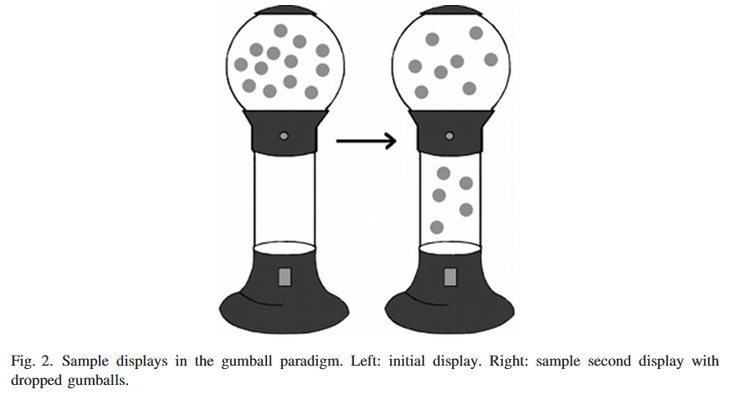
Processing Scalar Implicature: A Constraint-Based Approach (Degen, Tanenhaus 2014)

Slide 35
Processing Scalar Implicature: A Constraint-Based Approach (Degen, Tanenhaus 2014)
Three experiments investigated the processing of the implicature associated with some using a “gumball paradigm.”
On each trial, participants saw an image of a gumball machine with an upper chamber with 13 gumballs and an empty lower chamber. Gumballs then dropped to the lower chamber and participants evaluated statements, such as “You got some of the gumballs.”
Experiment 1 established that some is less natural for reference to small sets (1, 2, and 3 of the 13 gumballs) and unpartitioned sets (all 13 gumballs) compared to intermediate sets (6–8). Partitive some of was less natural than simple some when used with the unpartitioned set.
In Experiment 2, including exact number descriptions lowered naturalness ratings for some with small sets but not for intermediate size sets and the unpartitioned set.
In Experiment 3, the naturalness ratings from Experiment 2 predicted response times. The results are interpreted as evidence for a Constraint-Based account of scalar implicature processing and against both two-stage, Literal-First models and pragmatic Default models.

Slide 36
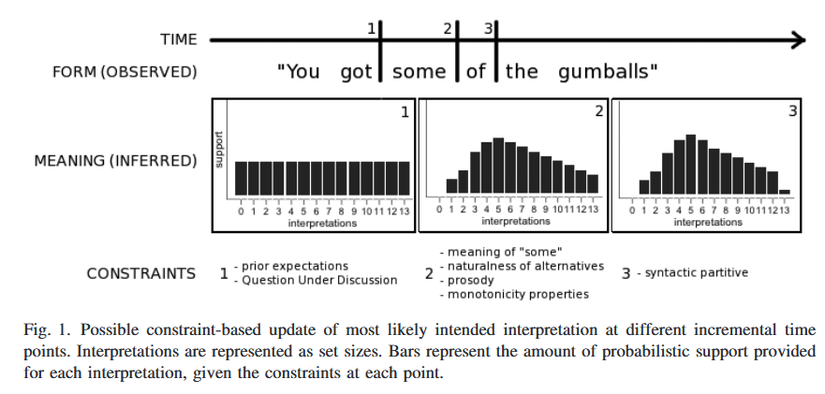
Processing Scalar Implicature: A Constraint-Based Approach (Degen, Tanenhaus 2014)

Slide 37
Processing Scalar Implicature: A Constraint-Based Approach (Degen, Tanenhaus 2014)
Under the Default model, the distribution on states would be uniform until the word some is encountered, at which point both the zero-gumball and all-gumball state would be excluded as potential candidates, leaving a uniform distribution over states 1–12.
The Literal-First model predicts that upon encountering some, only the zero-gumball state should be excluded.
Both models predict that over time, the integration of further contextual information may require re-including the all-state in the set of possible states (Default), or excluding the all-state from said set (Literal-First).
Neither of these models directly predicts variability in naturalness of partitive versus non-partitive some for any set size, nor variability in the naturalness of some used with different set sizes.

Slide 38
Processing Scalar Implicature: A Constraint-Based Approach (Degen, Tanenhaus 2014)

Slide 39
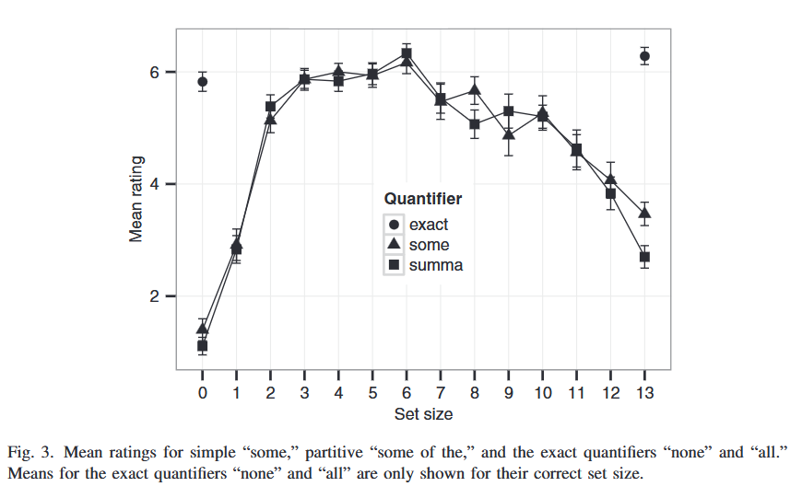
Processing Scalar Implicature: A Constraint-Based Approach (Degen, Tanenhaus 2014)
Experiment 1 was conducted to determine the naturalness of descriptions with some, some of (henceforth summa), all of (henceforth all), and none of (henceforth none) for set sizes ranging from 0 to 13.
You got X gumballs – how naturally the scene was described by the statement on a seven-point Likert scale, where seven was very natural and one was very unnatural.

Slide 40
Processing Scalar Implicature: A Constraint-Based Approach (Degen, Tanenhaus 2014)
Some and summa were both judged to be quite unnatural for set sizes of 1 and 2, and more natural but not quite as natural as for the preferred set size (six gumballs) for 3. Naturalness also decreased after the mid range (five to eight gumballs) and was low at the unpartitioned set. In addition, the partitive, some of, was less natural to refer to the unpartitioned set than simple some. Finally, we note that naturalness ratings for some/summa gradually decreased for set sizes above 6.

Slide 41
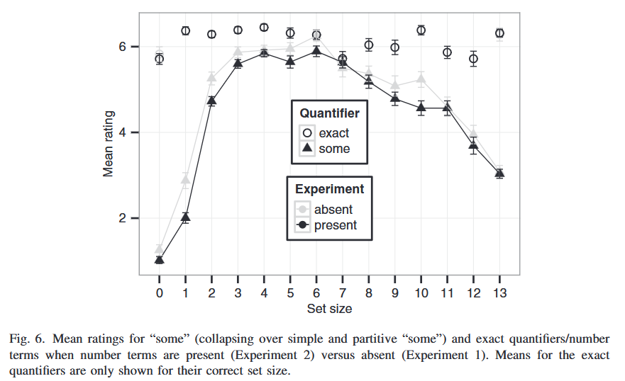
Processing Scalar Implicature: A Constraint-Based Approach (Degen, Tanenhaus 2014)
Experiment 2 tested the hypothesis that when number terms are included as alternatives within the context of an experiment, the naturalness of some will be reduced when it is used with small set sizes.

Slide 42
Processing Scalar Implicature: A Constraint-Based Approach (Degen, Tanenhaus 2014)
With the exception of 6 and 7 (around half of the original set size), numbers are always judged to be more natural than some/summa when they are intermixed.

Slide 43
Processing Scalar Implicature: A Constraint-Based Approach (Degen, Tanenhaus 2014)
Experiment 3 was designed to test whether the effect of available natural alternatives is reflected in response times. We recorded participants’ judgments and response times to press one of two buttons (YES or NO) depending on whether they agreed or disagreed with the description. The Constraint-Based account predicts that participants’ YES responses should be slower for more unnatural statements.
Note that neither the Default nor the Literal-First model predicts response time differences based on naturalness of alternatives—regardless of set size, processing of a statement with some should take the same amount of time, except for the unpartitioned set, where the Default model predicts longer response times for semantic YES responses and the Literal-First model predicts longer response times for pragmatic NO responses. In addition, neither of these models predicts when a statement with some should result in a pragmatic NO judgment despite being semantically true. In contrast, the Constraint-Based account predicts the proportion of NO judgments to be proportional to the naturalness of some used with that set size.

Slide 44
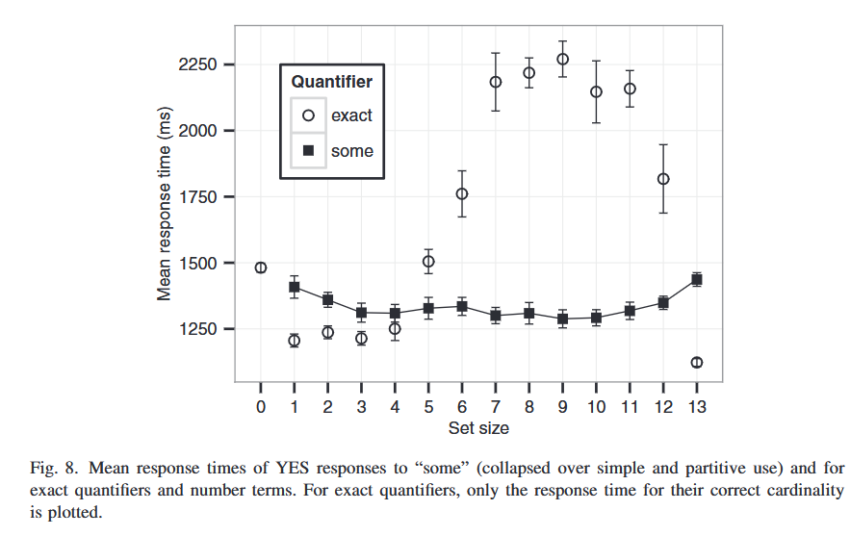
Processing Scalar Implicature: A Constraint-Based Approach (Degen, Tanenhaus 2014)

Slide 45
Processing Scalar Implicature: A Constraint-Based Approach (Degen, Tanenhaus 2014)
In rating studies in which the upper chamber began with 13 gumballs, we found the following results:
(1) some was less natural for small sets (1–3) than for intermediate size sets (6–8);
(2) exact number was more natural than some, with the effect being most pronounced for small and large set sizes;
(3) descriptions with some were less natural than descriptions with all for the unpartitioned set, with the effect more pronounced for partitive some than for simple some;
(4) intermixing exact number descriptions further lowered naturalness ratings for small sets (one, two, and three gumballs) but not for intermediate size sets.
The Literal-First account has trouble explaining the naturalness effects we observed for the YES responses, in particular the slower response time for YES responses to some/summa at the unpartitioned set compared to the preferred range.
Our results are also incompatible with the Default model, which assumes that scalar implicatures are computed by default, upon encountering some.

Slide 46
References
Banga A., Heutinck I., Berends S. M., Hendriks P. (2009). Some implicatures reveal semantic differences // Linguistics in the Netherlands / ed. by B. Botma, J. van Kampen. P. 1–13.
Chierchia G. (2004). Scalar implicatures, polarity phenomena and the syntax/pragmatics interface // Structures and beyond. Oxford University Press. P. 39–103.
Doran R., Ward G., Larson M., McNabb Y., Baker R. E. (2012). A novel experimental paradigm for distinguishing between what is said and what is implicated // Language. Vol. 88, No. 1. P. 124–154.
Foppolo F., Guasti M. T., Chierchia G. (2012). Scalar implicatures in child language: give children a chance // Language Learning and Development. Vol. 8, No. 4. P. 365–394.
Fox D. (2007). Free choice and the theory of scalar implicatures // Presupposition and implicature in compositional semantics / ed. by U. Sauerland, P. Stateva. Houndmills: Palgrave Macmillan. P. 71–120.
Gazdar G. (1979). Pragmatics: implicature, presupposition and logical form. New-York: Academic Press.
Geis M. L., Zwicky A. M. (1971). On invited inferences // Linguistic Inquiry. Vol. 2, No. 4. P. 561–566.
Geurts B. (2010). Quantity implicatures. Cambridge: Cambridge University Press.
Groenendijk J., Stokhof M. (1984). Studies in the semantics of questions and the pragmatics of answers: PhD thesis / Jeroen Groenendijk, M. Stokhof. University of Amsterdam.
Hirschberg, Julia. 1985. A theory of scalar implicature: University of Pennsylvania dissertation.
Horn L. R. (1972). On the semantic properties of logical operators in English: PhD thesis / Laurence R Horn. UCLA.
Horn L. R. (2000). From if to iff: conditional perfection as pragmatic strengthening // Journal of Pragmatics. Vol. 32, No. 3. P. 289–326.
Horn L. R. (2009). WJ-40: implicature, truth, and meaning // International Review of Pragmatics. Vol. 1. P. 3–34.
Jennings R. E. (1994). The “or” of free choice permission // Topoi. Vol. 13, No. 1. P. 3–10.
Katsos N., Bishop D. V. M. (2011). Pragmatic tolerance: implications for the acquisition of informativeness and implicature // Cognition. Vol. 120, No. 1. P. 67–81.
Katsos N. (2014). Scalar implicature // Pragmatic development in first language acquisition / ed. by D. Matthews. Amsterdam: John Benjamins Publishing Company. P. 183–197.
Matsumoto Y. (1995). The conversational condition on Horn scales // Linguistics and Philosophy. Vol. 18. P. 21–60.
Pouscoulous N., Noveck I., Politzer G., Bastide A. (2007). A developmental investigation of processing costs in implicature production // Language Acquisition. Vol. 14, No. 4. P. 347–376.
Rubio-Fernandez P. (2016). How redundant are redundant color adjectives? An efficiency-based analysis of color overspecification // Frontiers in Psychology. Vol. 7. P. 1–15.
Stiller A., Goodman N. D., Franke M., Frank M. C. (2011). Ad-hoc scalar implicature in adults and children // Proceedings of the thirty-third annual conference of the Cognitive Science Society / ed. by L. Carlson, C. Holscher, T. Shipley. Boston. P. 2134–2139.
van der Auwera J. (1997). Pragmatics in the last quarter century: the case of conditional perfection // Journal of Pragmatics. Vol. 27, No. 3. P. 261–274.

